Slide 1
Mobile Application Development
David Drohan (ddrohan@wit.ie)

Slide 2

Introducing Android
Part 1

Slide 3
Agenda
Background & History
Latest Features
The Mobile OS War

Slide 4
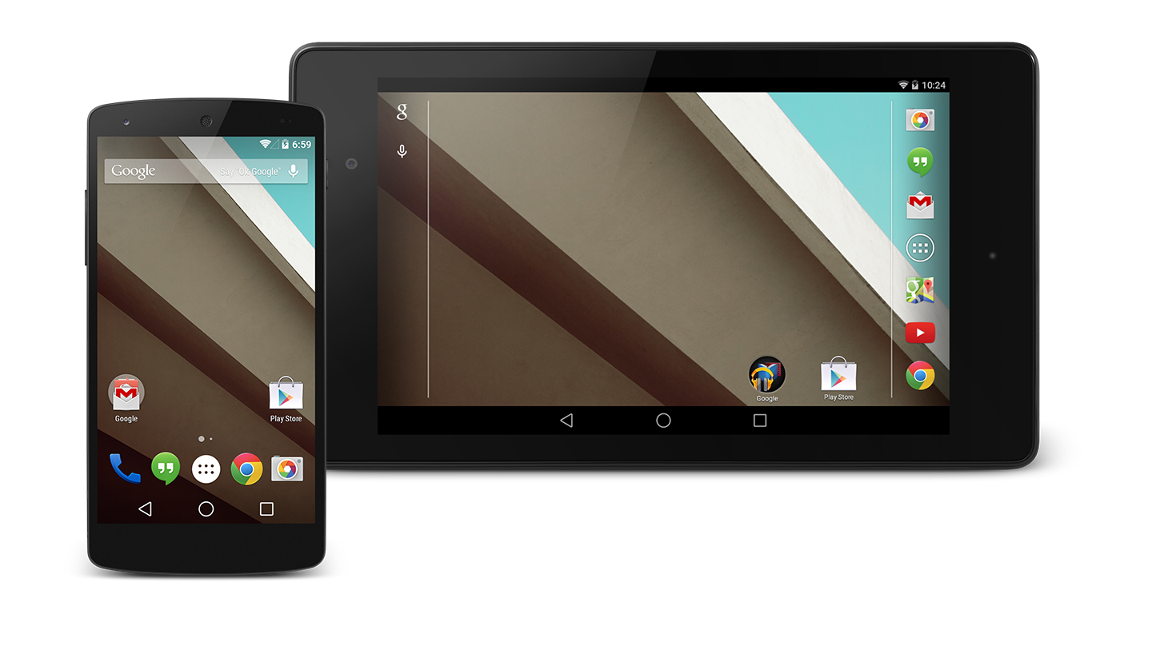
Background
Android is a comprehensive open source platform designed for mobile devices
It is championed by Google and owned by the Open Handset Alliance (84 companies, next Slide)
The goal of the alliance is to “accelerate innovation in mobile and offer consumers a richer, less expensive, and better mobile experience.” (November 2007)

Slide 5
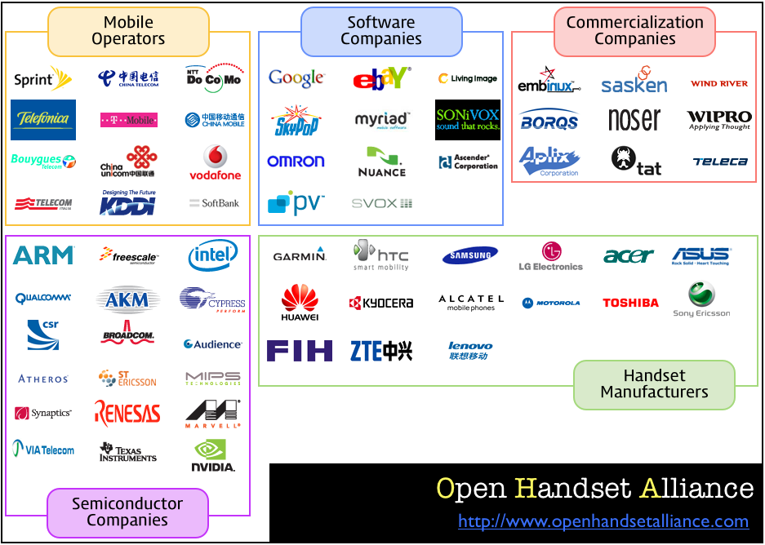

Slide 6
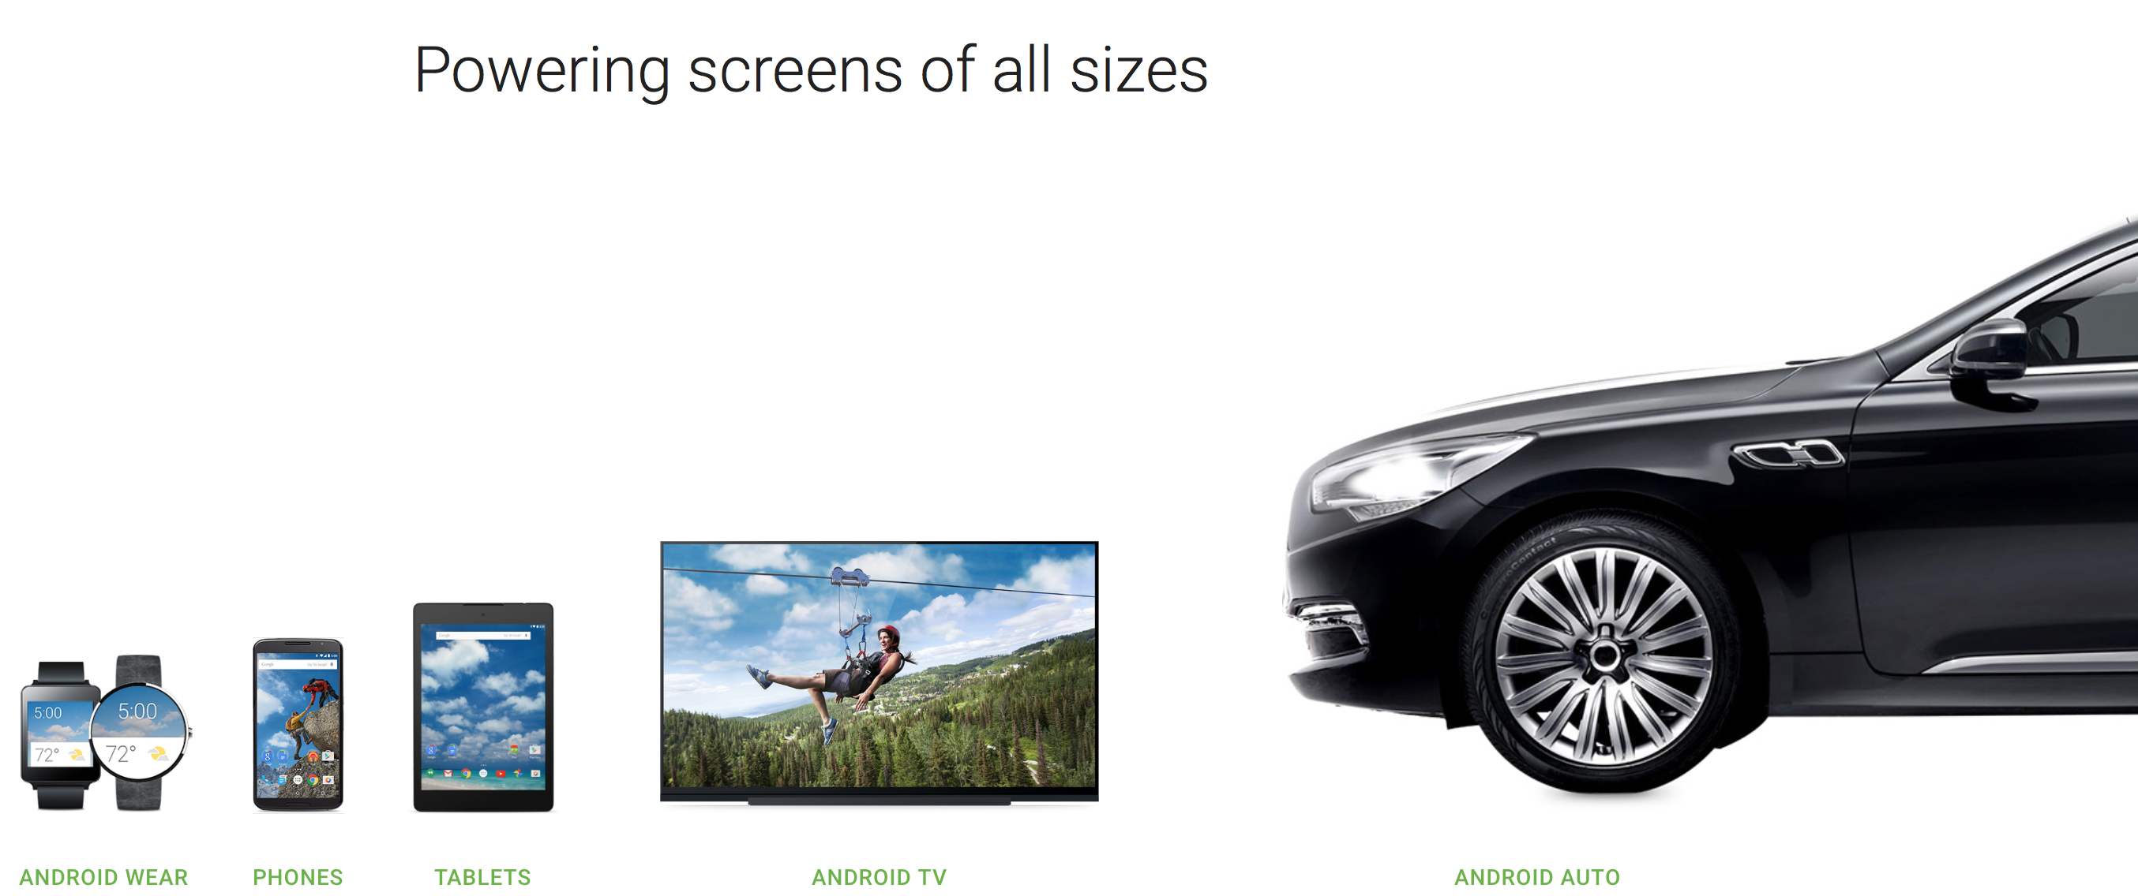
Background
Android, along with iOS, has (and continues to) revolutionise the mobile space.
Unlike iOS however, Android is an open platform that separates the hardware from the software that runs on it.
This allows for a much larger number of devices to run the same applications and creates a much richer ecosystem for developers and consumers.

Slide 7
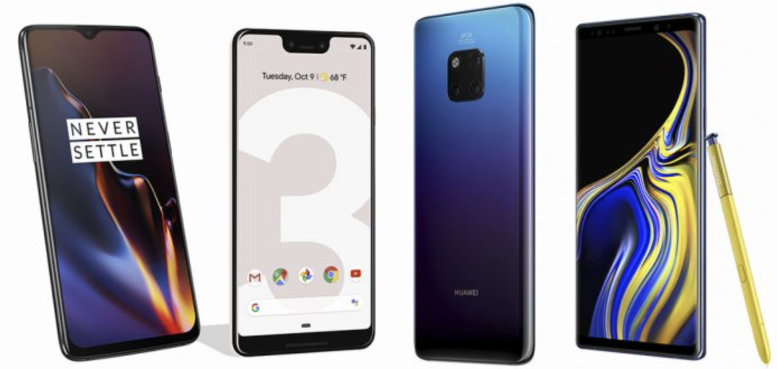
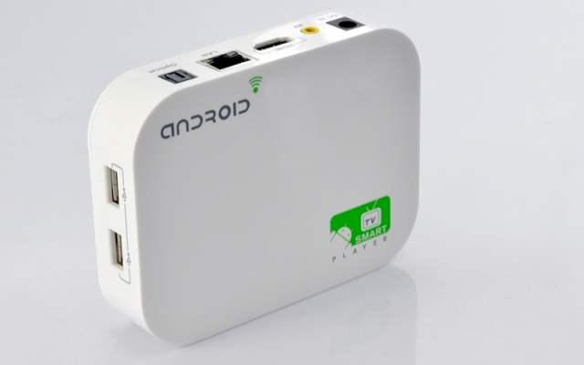
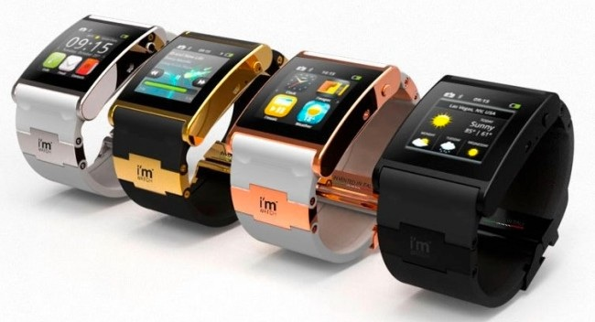
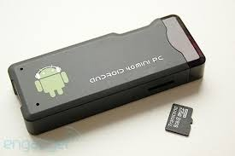
Designed for Mobile Devices
When designing Android, the team looked at which mobile device constraints were likely not going to change for the foreseeable future:
Battery power, and battery performance is probably not going to get massively better anytime soon
In general, the small size of mobile devices means that they will always be limited in terms of memory and speed
However, a device’s screen size, resolution, chipset may vary considerably
These constraints have been taken into consideration throughout the platform.
Introduction to Android

Slide 8
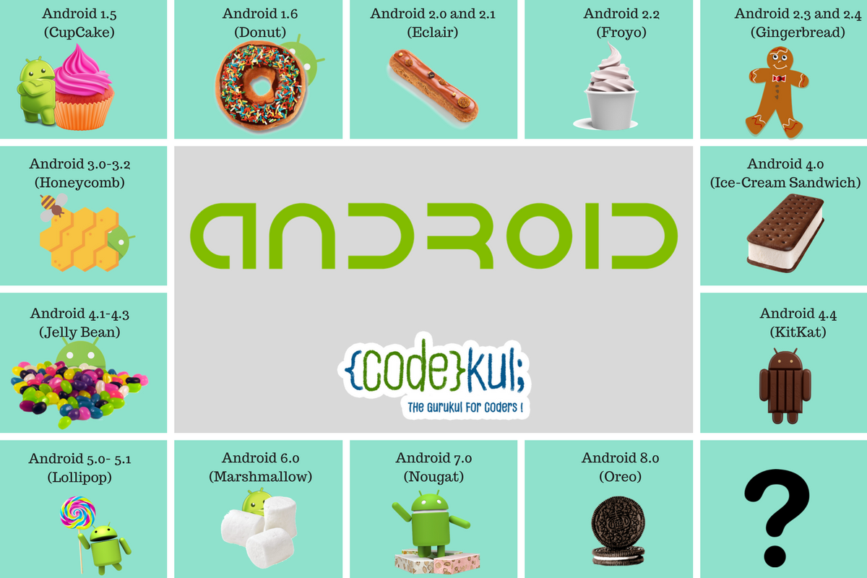

Android History / Versions so Far *
Android 9.0 (Pie)

Slide 9

Android History / Versions so Far *
Android 10 (API 29) as of September 3rd 2019?
Android 9.0 (Pie)

Slide 10
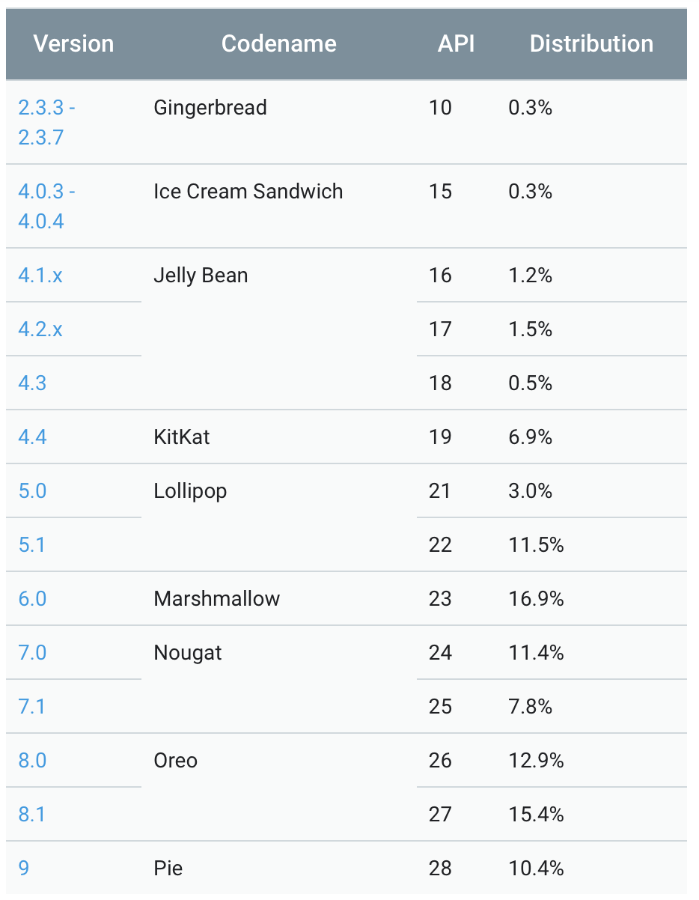
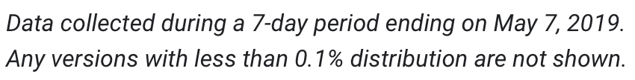
Versions – API Level *
The Android version number itself partly tells the story of the software platform’s major and minor releases. What is most important is the API level. Version numbers change all the time, sometimes because the APIs have changed, and other times because of minor bug fixes or performance improvements.
As an application developer, you will want to make sure you know which API level your application is targeting in order to run. That API level will determine which devices can and cannot run your application.
https://developer.android.com/about/dashboards

Slide 11
Versions – API Level *
The Android version number itself partly tells the story of the software platform’s major and minor releases. What is most important is the API level. Version numbers change all the time, sometimes because the APIs have changed, and other times because of minor bug fixes or performance improvements.
As an application developer, you will want to make sure you know which API level your application is targeting in order to run. That API level will determine which devices can and cannot run your application.
https://developer.android.com/about/dashboards

Slide 12
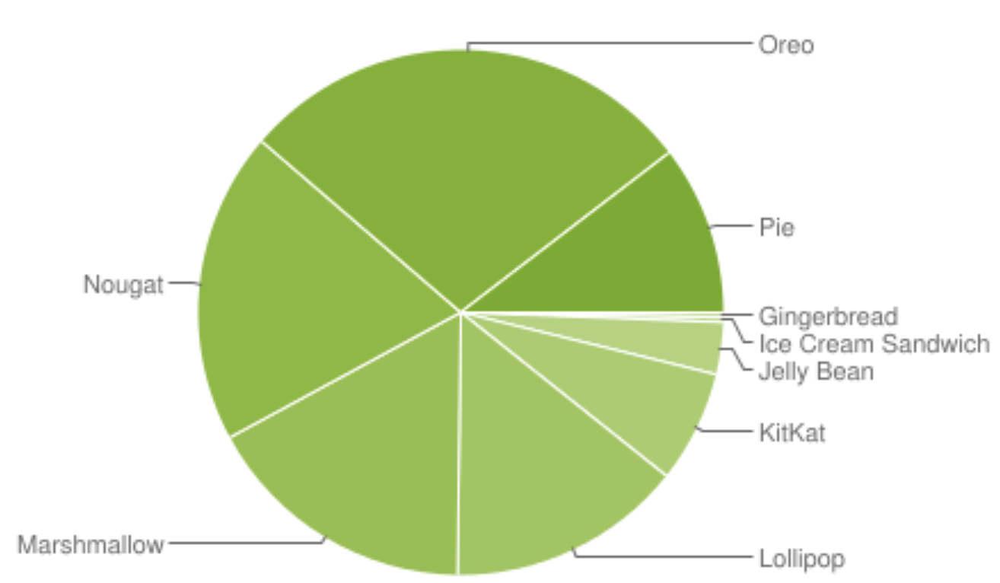
Versions – Platforms *

Slide 13
Versions – Platforms *
64.4%

Slide 14
Target Version
A developers objective may be to have an application run on as many devices as possible.
shoot for the lowest API level possible. But keep in mind the distribution of Android versions on real devices out there.
There are a lot of users (64.4%) of Android 6.x 7.x & 8.x. This places these few versions as the largest versions currently out there.
This hasn’t always been the case because OEMs tended to be very slow in upgrading their OS versions. However, this has changed with Google’s strong push to get everyone onto the latest versions.
However, there are still a not insignificant number of people (10%+) who have anything from the 2.3.3 version to the 4.4 version because they have yet to upgrade their phones to a phone with the hardware capable of handling the newer versions.

Slide 15
Android Version 10 - Highlights
(Un)Official Release Date September 3rd 2019 (1st Beta March 13th)
For the first time ever, it won’t be named after a sweet, treat or desert
Rolled out for Google Pixel range (+ some other OEMs, Huawei, OnePlus, LG, Nokia)
Improvements and updates fall into three main categories:
Innovation
Security & Privacy, and
Digital Wellbeing

Slide 16
Android Version 10 - Highlights
Bid farewell to the back button (uses swipe gestures instead)
DARK Mode is Official
Some new theming options
Live Caption works ☺ (all done locally on device)
App permissions getting an overhaul (location a big one)
There’s a new share menu
Foldable phones are natively supported

Slide 17
Adoption Rates
Android adoption traditionally lags behind Apple's because Apple can make its latest iOS available for all users at once because it makes all the hardware and the software.
Android, on the other hand, is much more fragmented. Because Google lets many different hardware makers use its Android software, it can't control when all phones update to the latest software. So, the newest version of Android is always made available for Google's lineup of smartphones and tablets, but it can't release software updates to every single Android phones at once.
Smartphone manufacturers often add their own modifications to Android, which means that the update needs to be approved by each individual carrier first.
This means that depending on which phone you own, it could take ages to receive the latest software update.
Here's the brutal chart:

Slide 18
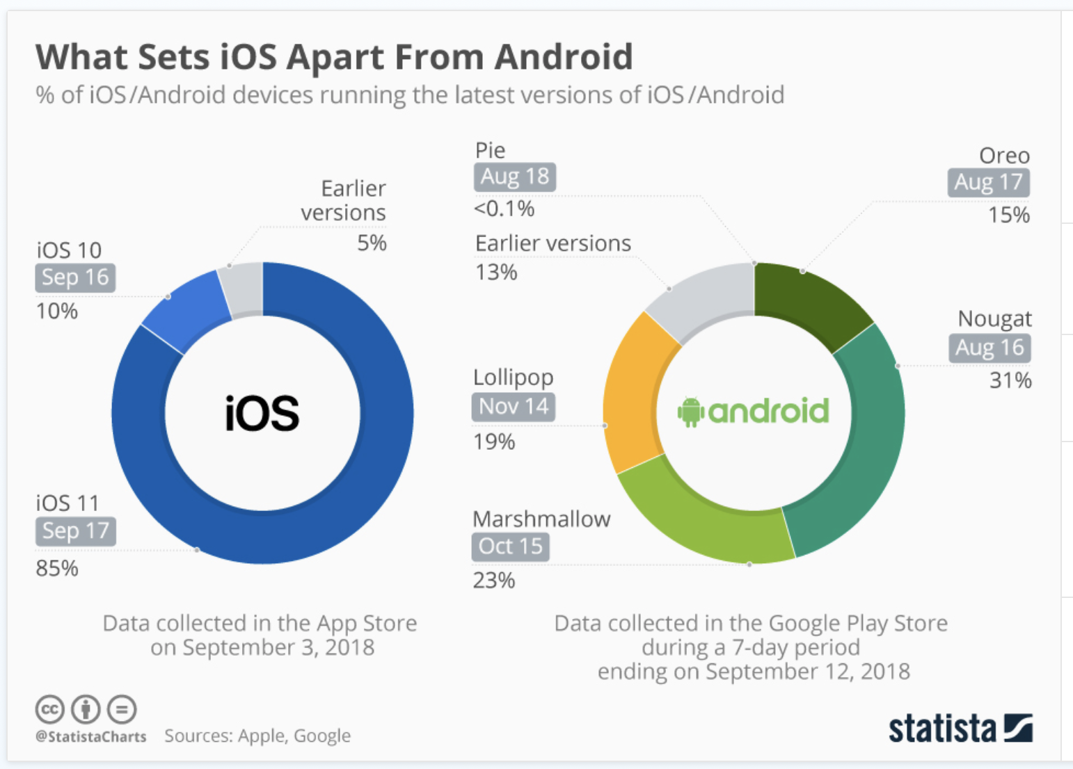
Adoption Rates
https://www.statista.com/chart/5930/adoption-of-ios-and-android-versions/

Slide 19
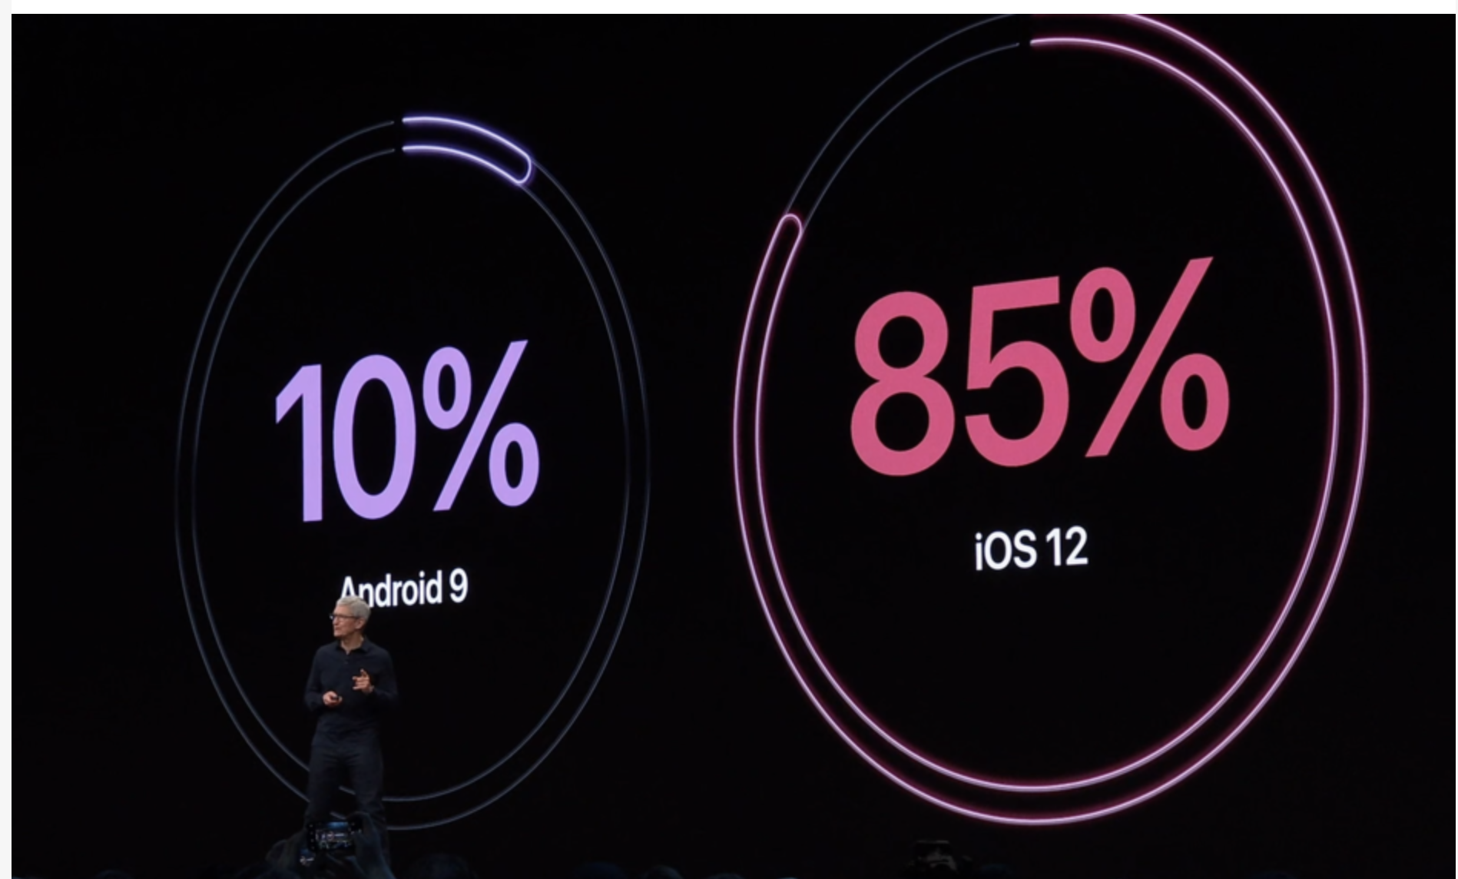
Adoption Rates (June 04th 2019 WWDC)
CEO Tim Cook was keen to point out, Apple’s latest numbers are in stark contrast to the latest offering from “those other guys.”

Slide 20
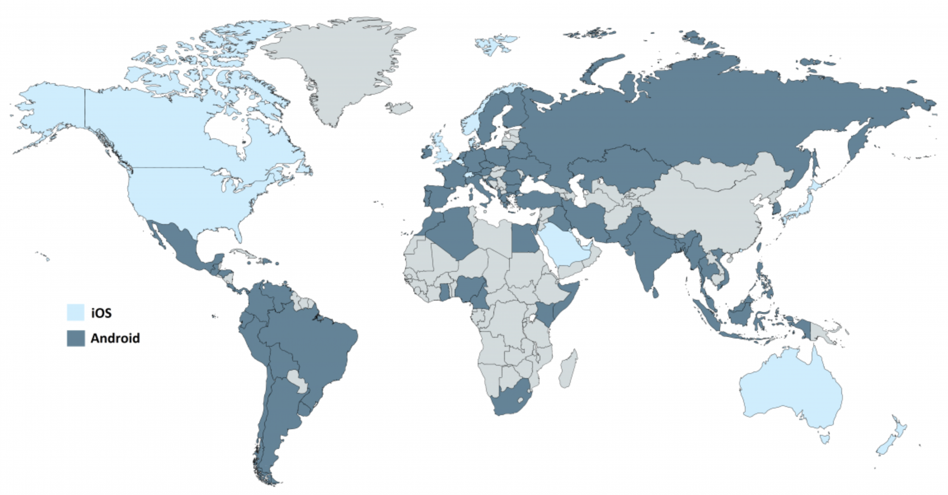
Which Countries Prefer What (31st May 2019)
https://deviceatlas.com/blog/android-v-ios-market-share

Slide 21
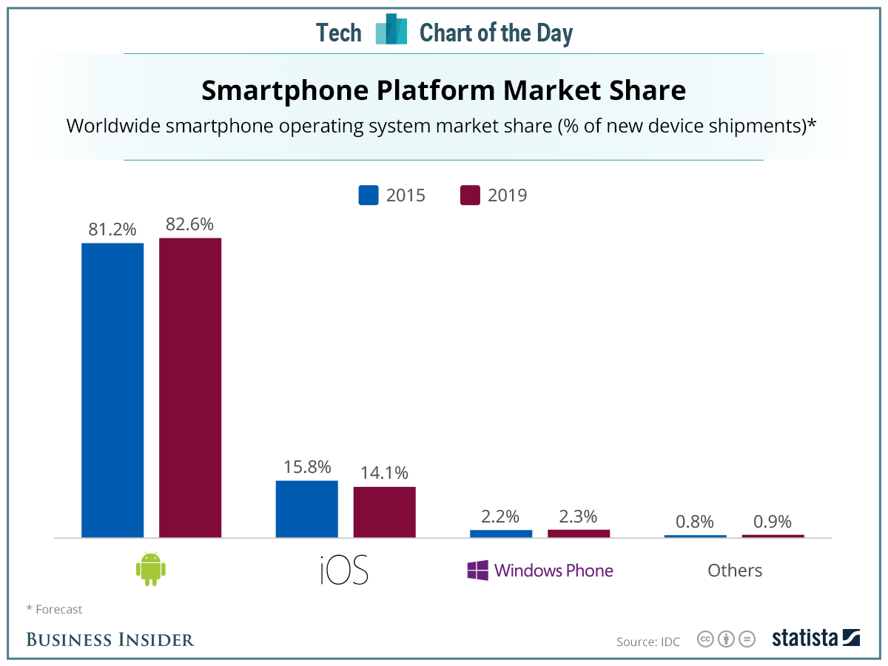
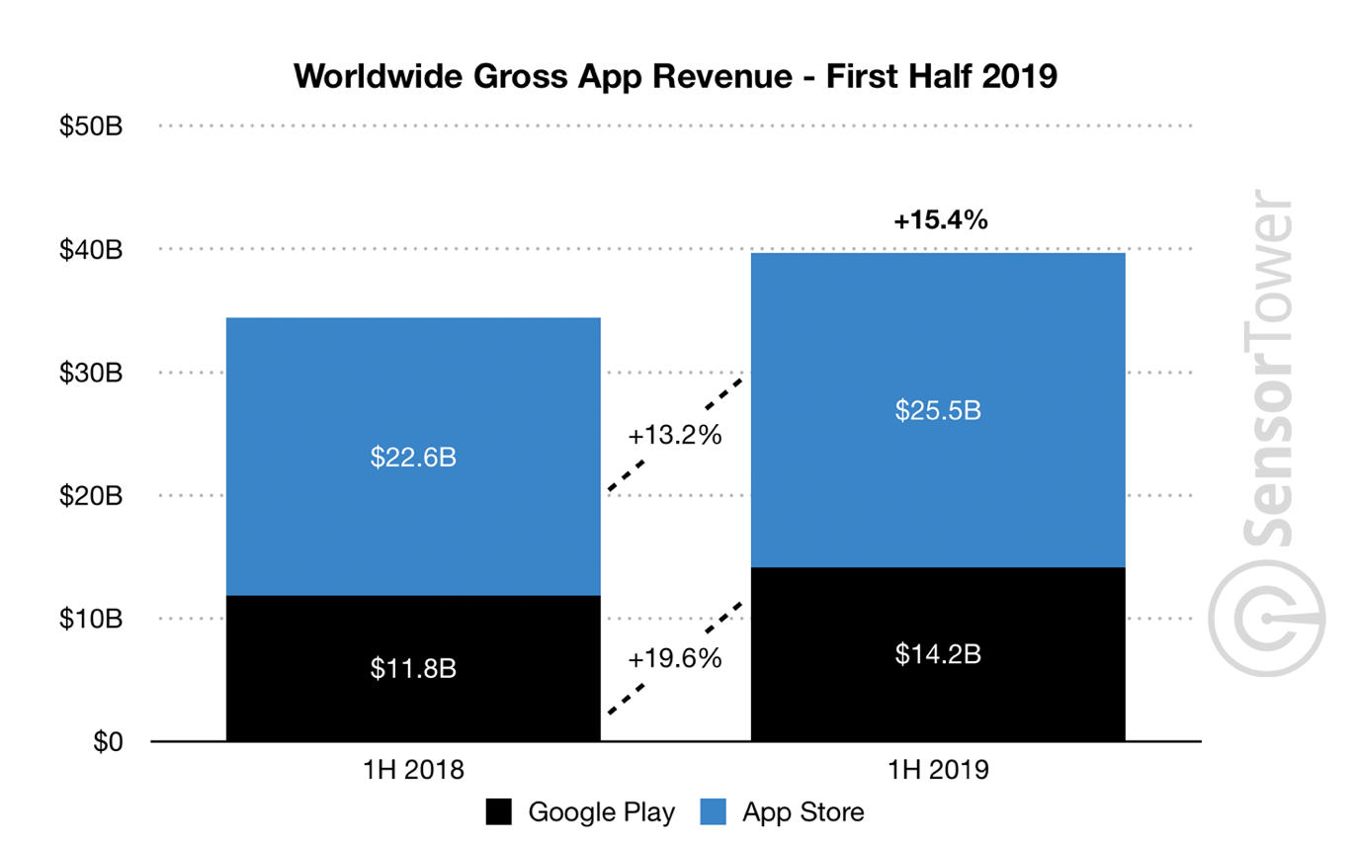
Market Share Vs App Revenue

Slide 22
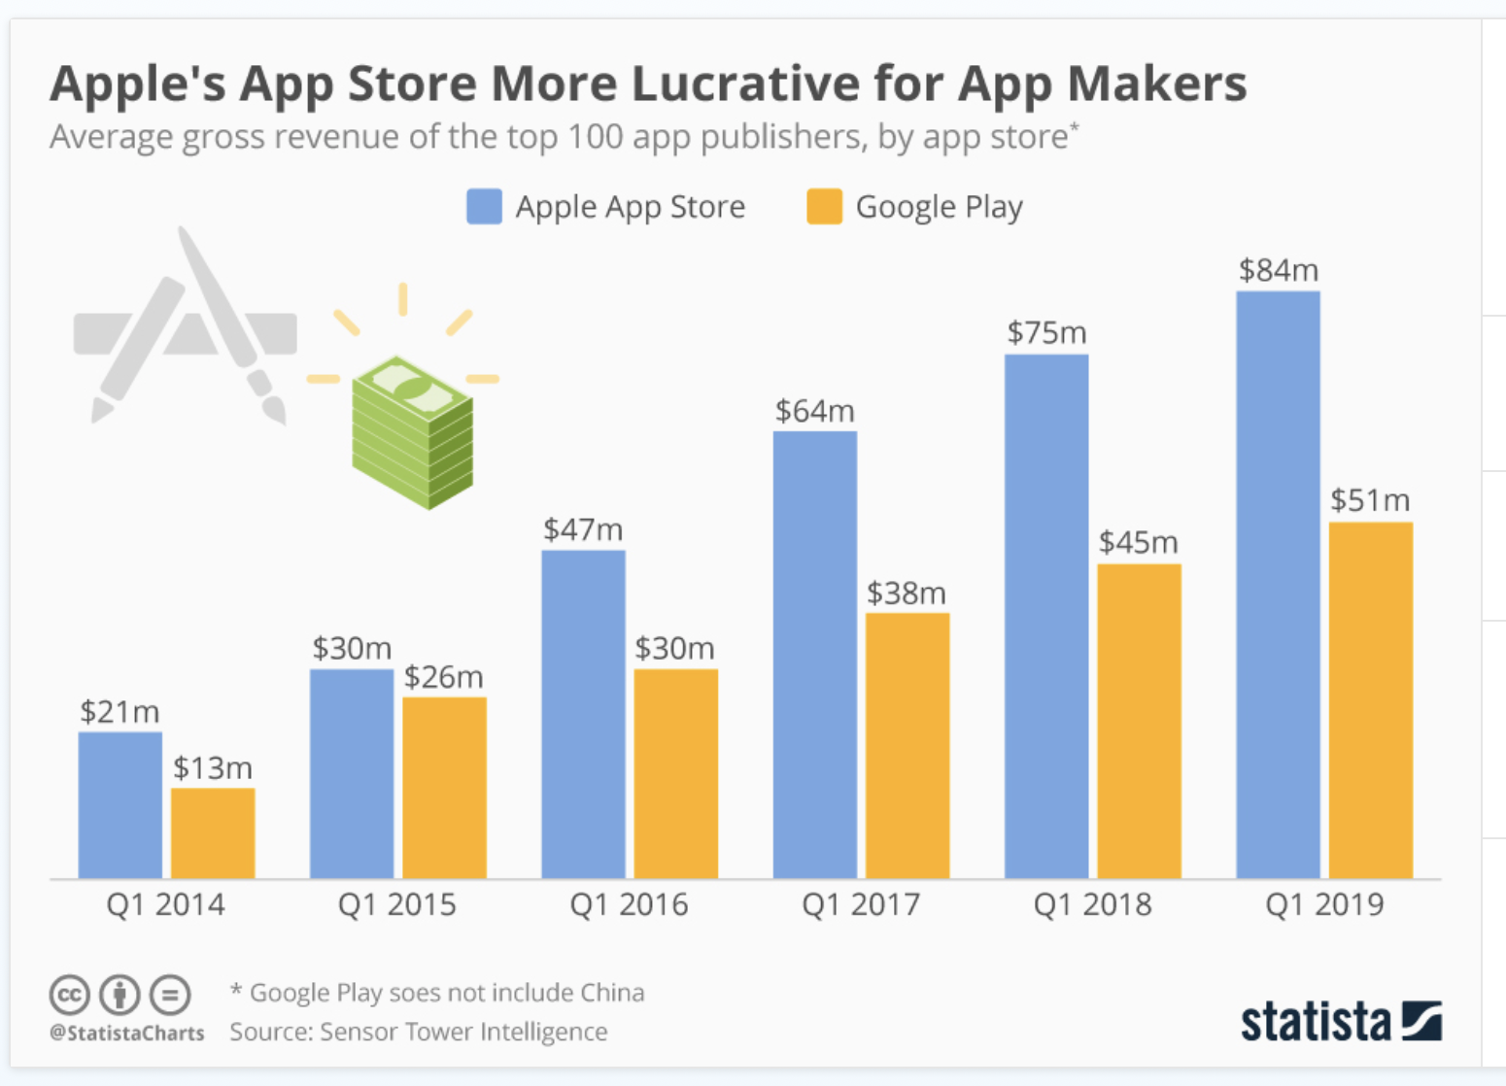
App Store Vs Google Play

Slide 23
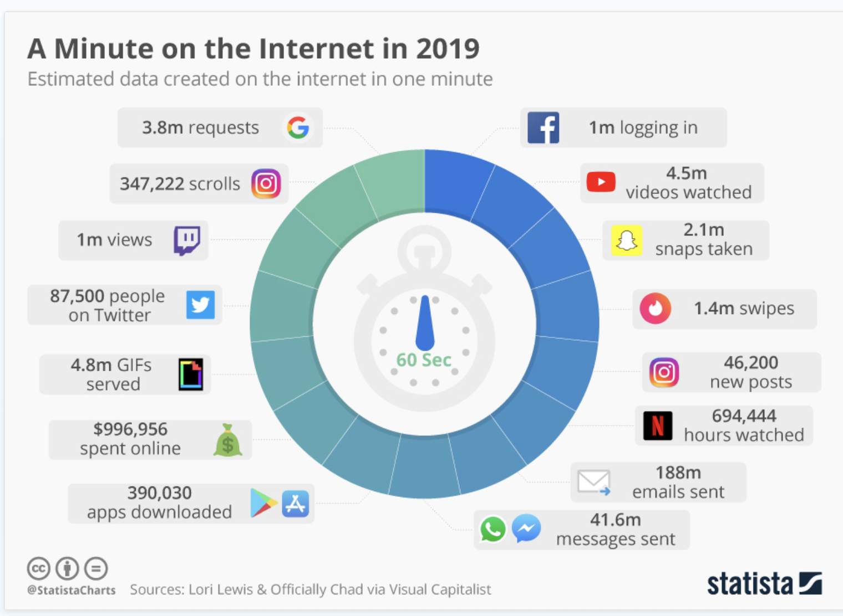

Slide 24
References
Online references
http://developer.android.com/
By far the most important single reference.
https://www.techadvisor.co.uk/news/google-android/android-10-3689677/
https://www.zdnet.com/article/android-10-release-date-features-rumors-and-everything-we-know-so-far/
https://www.statista.com/chart/5930/adoption-of-ios-and-android-versions/
https://www.phonearena.com/news/Apple-iOS-12-adoption-rate-85-percent-Android-comparison_id116546
https://www.express.co.uk/life-style/science-technology/1136137/Android-vs-iOS-Apple-reveals-major-advantage-over-Google
https://www.androidcentral.com/android-q#theme
Introduction to Android

